Slide 1

PLAGIARISM ANALYSER

Slide 2

TEAM MATES
A.Venkata Dinesh Reddy
(RA1911028010098)
CH.Vamshi Krishna
(RA1911028010099)
CH . Prashanth
(RA1911028010101)
Kannanoor Spurgeon
(RA1911028010109)
K . Shiva Gyaneshwar
(RA1911028010133)

Slide 3
INTRODUCTION
Plagiarism detection is the process of locating instances of plagiarism or copyright infringement within a work or document.
The widespread use of computers and the advent of the Internet have made it easier to plagiarize the work of others.
plagiarism checker can detect plagiarism from billions of web pages.
This plagiarism check will tell you whether or not your text contains duplicate content
A plagiarism checker uses advanced database software to scan for matches between your text and existing texts.

Slide 4

LIBRARIES USED:
Flask
Pandas
Difflib
Natural language toolkit (NLTK)
Beautiful Soup
Request

Slide 5
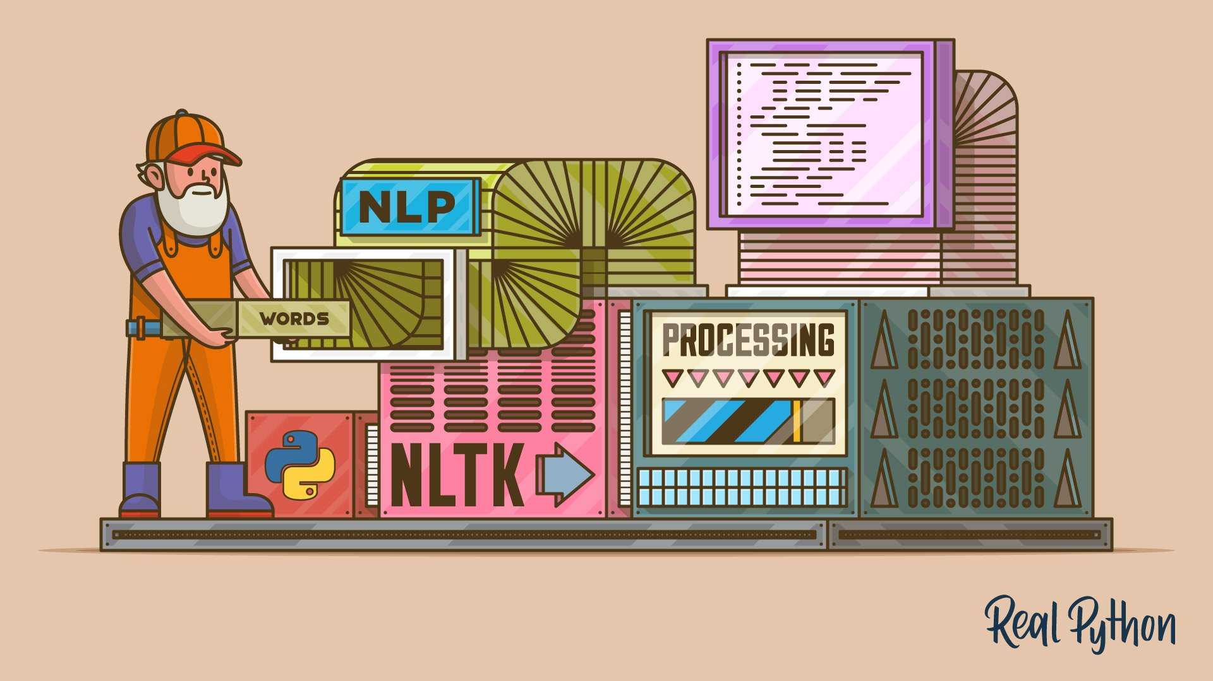
VISUAL PICTURE

Slide 6
The following are considered as Plagiarism:
Turning in someone else's work as your own.
Copying words or ideas from someone else without giving credit.
Failing to put a quotation in quotation marks.
Giving incorrect information about the source of a quotation.
Changing words but copying sentence structure.
Copying so many words of ideas from a source that it makes up the majority of your work. Even though by credit.

Slide 7
WORKING PROCESS
The UI features a simple textarea input in which the user can paste the text from an article. When the user clicks the Submit button, this input is used to query a database of articles. Results and their match scores are then displayed to the user. To help reduce the amount of noise, the app also includes a slider input in which the user can specify a similarity threshold to only show extremely strong matches.

Slide 8
As you can see, when original content is used as the search input, the match scores for possibly plagiarized articles are relatively low. However, if we were to copy and paste the text from one of the articles in our database, the results for the plagiarized article come back with a 99.99% match!
This is done using Python Flask that utilizes the Pinecone SDK. The HTML uses a template file, and the rest of the frontend is built using static CSS and JS assets.

Slide 9
ADVANTAGES
The system designed to detect similarity among text documents calculates content similarity among specified documents.
Applying efficient string-matching algorithm, which will further reduce the time and increase the efficiency.
This system is simple and easy to access.
System will give accurate results based on the content provided.
This system will generate results in very less time.
Code is short and simple to understand

Slide 10
DISADVANTAGES
Active internet connection required.
If user uploads an incorrect document, then the result won’t be accurate.
Takes more time to get results if input data is large.
Input should give as text and docx, pdf formats are not supported.
The plagiarism tool can accurately detect plagiarism when the text is comprised of seven or more than seven words but it cannot work as well with the text of smaller words.

Slide 11
Deployment of advanced algorithms
Algorithms are the identity of AI. For comparing two texts the system contributes some advanced algorithms. These algorithms take the sample content and analyze the words in sequence.
Then word by word AI algorithms match the entire text with the millions of webpages on the internet. If the content is found to be similar or the same, the detector shows the error.
Karp-Rabin algorithm, string matching algorithm are used in our project.

Slide 12
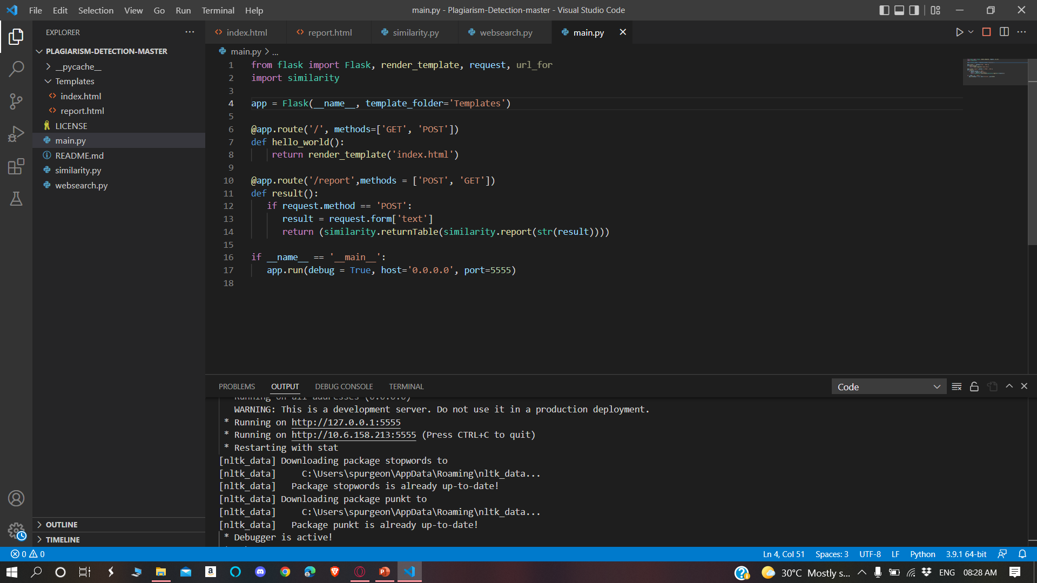
DESKTOP PROJECT

Slide 13
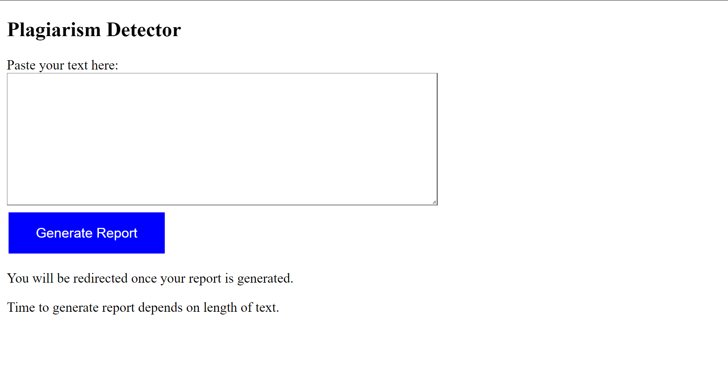
DESKTOP PROJECT

Slide 14
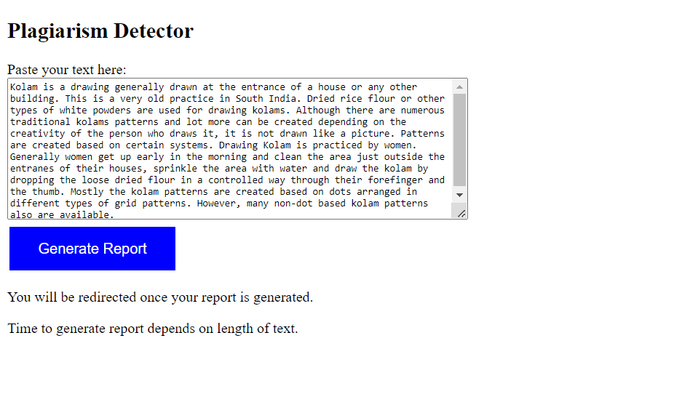
Let’s take an example and copy some text from a site and check the plagiarism of that text

Slide 15
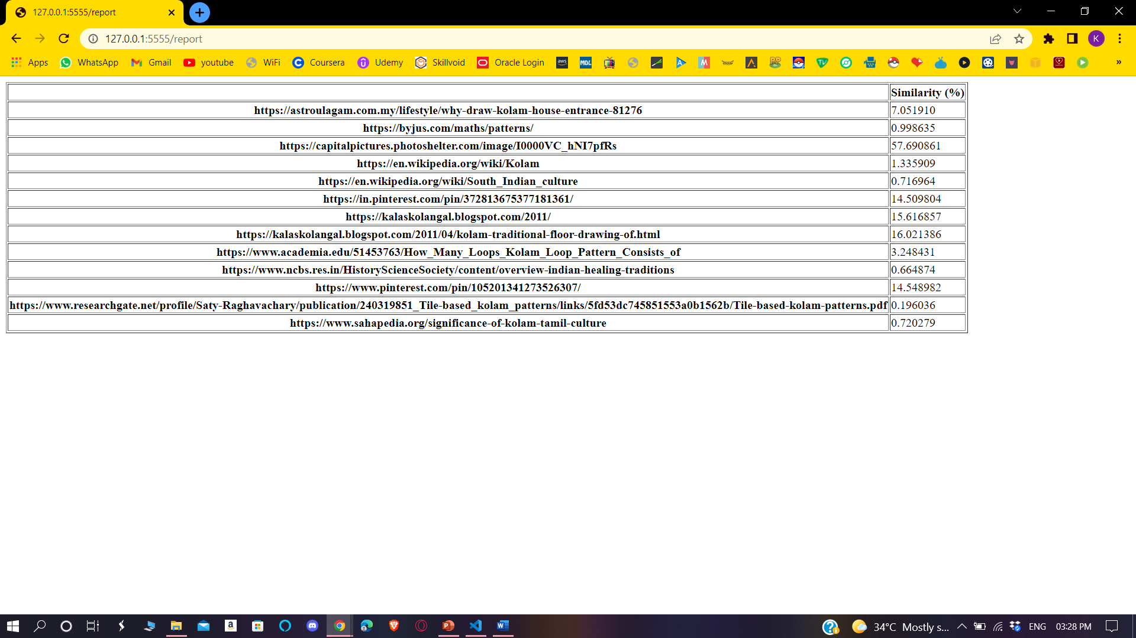
This shows the percentage from which site, the text has been copied.

Slide 16
CONCLUSION
Plagiarism is rampant now. With most of the data available to us in digital format the venues for plagiarism is opening up.
To avoid this kind of cheating and to acknowledge the originality of the author, new detection techniques are to be created.
To protect the intellectual property source code new techniques are to be developed and implemented.
So, this is one of the technique which is used to find out the source site from which you have copied the matter.

Slide 17
